Slide 1
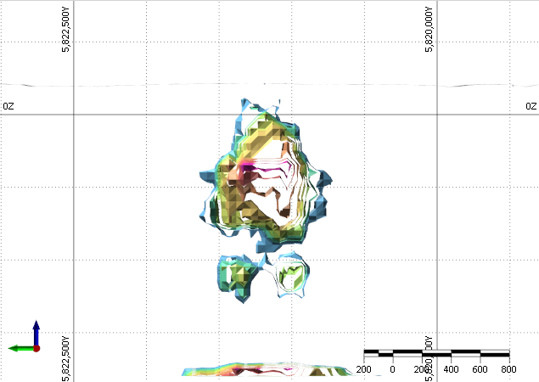
3D porphyry footprint modeling of air-core and soil geochemistry data, Stavely, Victoria Stavely Minerals Ltd September 2023
by Dan Core, Fathom Geophysics dan@fathomgeophysics.com

Slide 2
DOCUMENT SECTION | PAGE
Introduction | 2
Description of data | 2
Footprint modeling method | 2
Footprint modeling results | 3
Reference | 4
Threshold table | 5
Target table | 5
Figures | 6
Location maps | 6
Porphyry model | 11
Targeting results plan view | 12
Targeting results cross-section view | 14

Slide 3
Introduction
The goal of this work is to generate 3D targets indicating possible porphyry copper mineralization in the Stavely, Victoria project area. The input data for the work are geochemical data for auger soil and air core samples that were provided to Fathom Geophysics by Stavely Minerals Ltd with coordinates in GDA94 MAG Zone 54. This coordinate system was used for all outputs.
Description of Data
The soil and air core data were evaluated to determine which samples were appropriate for the footprint analysis. Many points lacked data necessary for the footprint analysis or had detection limits that were too high. These points were removed. The distribution of samples that were appropriate for analysis are shown in Figures 1 and 2.
The final dataset consists of 1532 auger soil samples and 390 air core samples. The soil samples have relatively consistent distribution over the southern and central part of the project area. The air core samples are concentrated around individual prospects.
Footprint Modeling Method
The porphyry footprint modeling method works by taking an idealized model of a porphyry copper system and moving it through 3D space. The core of the system is placed at every voxel in a 3D model. At every voxel, the fit between observed data and the idealized model are examined and a score is assigned with a value between 0 and 1.
A value of 1 indicates that the geochemical data perfectly match the idealized porphyry model and there is a high likelihood of a porphyry core at the pixel location. A value of 0 indicates that the data do not match a porphyry system at all and there is a low likelihood of a porphyry core at the pixel location. When looking at rock samples, we typically look for values greater than 0.2 over approximately 1km distance for a high-quality target.
The idealized model used for this work was been derived from Halley et al (2015). The geochemical model (Figure 3) is largely derived from Yerington but does include zonation information from other significant porphyry deposits.
The thresholds from the published models are not typically valid to use with soil samples due to leaching during weathering. We use the 90th percentile for each element in the soil dataset as the threshold values while preserving the geometry of the published models. The thresholds used for the models are shown in Table 1.

Slide 4
Footprint Modeling Results
Plan views of the results of the processing are shown in Figures 4 and 5. Table 2 summarizes the targets derived from the results.
Four porphyry targets and one epithermal targets were generated using the soil analyses. Target FG-Stavely-S-3 is the highest scoring of these targets. A cross-section view of the target is shown in Figure 6. It is located in the southeastern part of the project area at a depth of approximately 500m. It should be considered the highest priority of the soils targets.
Target FG-Stavely-S-2 is located approximately 3km NE of FG-Stavely-S-3 and also merits follow-up work. A cross section of the target is shown in Figure 7. It models at a depth of 1km, so it might not be explorable. However, the modeling of depth on soils targets can have significant uncertainty. It is also possible that the area is prospective for epithermal mineralization if there is a deep porphyry system present.
Targets FG-Stavely-S-1 and FG-Stavely-S-4 score lower than targets FG-Stavely-S-2 and FG-Stavely-S-3. However, FG-Stavely-S-1 and FG-Stavely-S-4 have greater total metal enrichment in the vicinity of the targets. They score lower because they are high in multiple metals from different parts of the theoretical porphyry model, so the scores are lower than areas that have lower total metal but better match a particular part of the porphyry model. These targets both merit follow-up air core sampling.
A section through FG-Stavely-S-4 and FG-Stavely-S-Epi1 is shown in Figure 8. Both targets have a deep component that suggests possible epithermal mineralization, but FG-Staely-S-4 also has a shallower porphyry target. Target FG-Stavely-S-1 is roughly coincident with target FG-Stavely-AC-3A. However, air core sampling has not been completed over the highest-scoring part of the soils target.
Four targets were also generated from the air core results. A cross section through target FG-Stavely-AC-2 is shown in Figure 9. It is a high scoring target and merits follow-up work including eventual diamond drilling, but the exact location of the best part of the target is poorly constrained due to relatively poor sample distribution. Some additional air core sampling would be beneficial to better constrain the target.
Figure 10 shows a section through targets FG-Stavely-S-1 and FG-Stavely-AC-3A. The targets are significantly offset from one another. Air core sampling over FG-Stavely-S-1 should help better constrain the targets in the area.
Targets FG-Stavely-AC-1, FG-Stavely-AC-3A, and FG-Stavely-AC-3B have the best part of the target plotting on the edge of the sample distribution. These areas merit additional air core drilling to provide better constraints on the target quality and geometry.

Slide 5
Reference
Halley, S., Dilles, J.H., and Tosdal, R.M., 2015, Footprints: Hydrothermal alteration and geochemical dispersion around porphyry copper deposits. SEG Newsletter, no. 100, pp 1 and 12-17.
Threshold table
Table 1: Table showing the Halley model and the 90th percentile thresholds for the Stavely soil data
Model | As | Bi | Cu | Li | Mo | Sb | Se | Sn | Te | Tl | W
Halley model | 50 | 1 | 1000 | 15 | 5 | 4 | 4 | 4 | 1 | 1.5 | 5
90th Percentile | 20.3 | 0.45 | 62.5 | 43.1 | 2.6 | 1.3 | 2 | 3.5 | 0.08 | 0.8 | 3.4

Slide 6
Target table
Table 2: Table showing the targets highlighted by the footprint modeling processing applied to the Stavely soil and air core data.
Target | X | Y | RL | DEM | Depth | Score | Comments
FG-Stavely-S-1 | 641940 | 5836030 | -46 | 270 | 316 | 0.11 | Coincident with target AC-3A. Relatively low scoring target, but coincidence with the AC results means it is probably worth following up.
FG-Stavely-S-2 | 647070 | 5824260 | -800 | 240 | 1040 | 0.18 | Target is relatively high scoring but is quite deep.
FG-Stavely-S-3 | 649270 | 5821230 | -300 | 210 | 510 | 0.2 | High scoring target at explorable depth. Aircore should be completed over this target.
FG-Stavely-S-4 | 645790 | 5816430 | -350 | 220 | 570 | 0.11 | Target score is similar to target S-1. It appears to be around the same depth as S-3. Follow-up should be completed if any other data support the area as a target.
FG-Stavely-AC-1 | 640150 | 5847930 | -320 | 270 | 590 | 0.25 | Reasonably high scoring but poorly constrained target at the edge of the sampling. Additional aircore samples are required to better constrain the target location and depth.
FG-Stavely-AC-2 | 630300 | 5845980 | -380 | 250 | 630 | 0.31 | Highest scoring AC target. Better constrained than AC-1, but it could still use better sample density to optimize drill targeting. The target is worth following up.
FG-Stavely-AC-3A | 641950 | 5835540 | 130 | 280 | 150 | 0.12 | Poorly constrained at the edge of sampling. The score is relatively low, but that may because samples were not taken directly over the soils target (S-1) that is nearby. Aircore should probably be extended over the soils target.
FG-Stavely-AC-3B | 642500 | 5834930 | 110 | 280 | 170 | 0.2 | Relatively high-scoring target on the edge of sampling. Soils in this area did not highlight a target. They highlighted S-1 to the NNW of AC-3B. Extending aircore coverage to the west to cover the highest scoring part of this target and north to cover the soils target would help with constraining drill targets in this area.
FG-Stavely-S-Epi1 | 643830 | 5818120 | -1750 | 220 | 1970 | 0.1 | Very deep target that may be more likely to be an epithermal system. The target scores relatively low, but the area has significant metal enrichment and is probably worth following up.

Slide 7
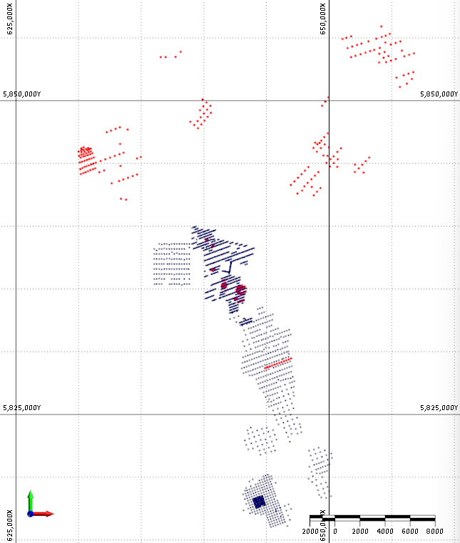
Location map – soils colored by Cu
Figure 1: Location map for the Stavely project area showing the soil samples as black points and the air core samples as red points.

Slide 8
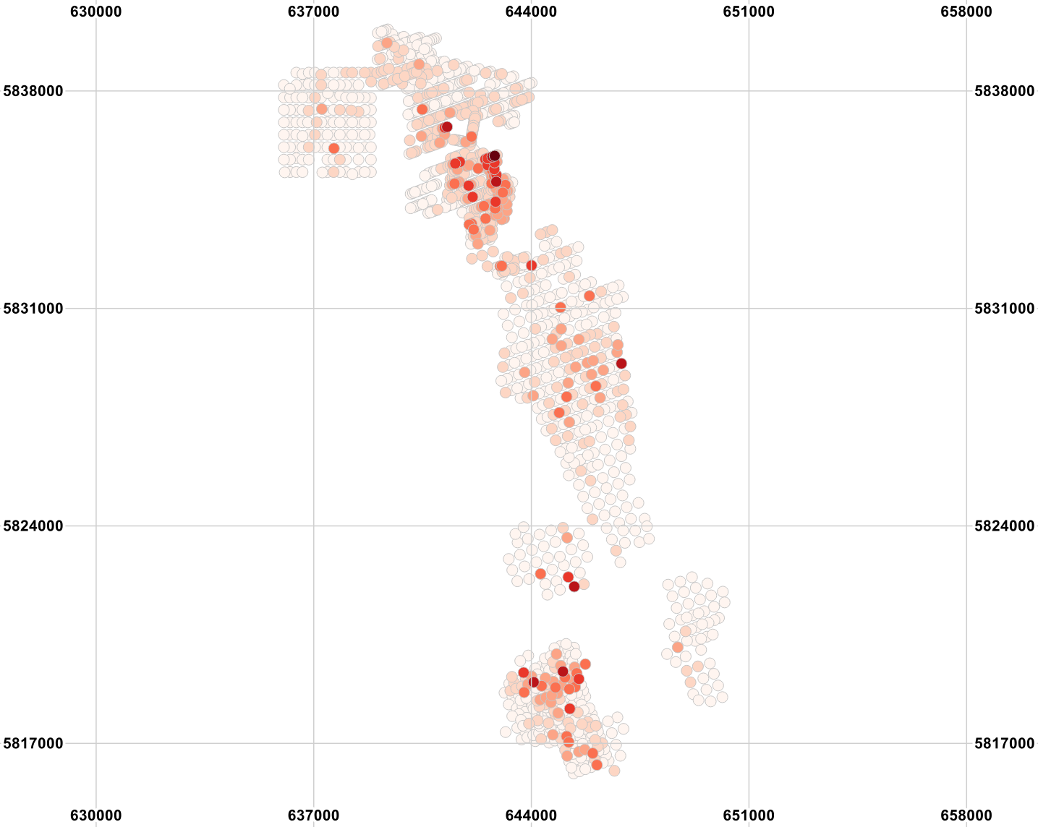
Location map – soils colored by Cu
Figure 2A: Soil sample locations for the Stavely project area colored by Cu concentration. The area in the magenta oval shows significant enrichment in several metals. The area is a relatively low scoring target because the element zonation does not match the idealized porphyry model. This could be caused by issues using the internal statistics of the soil dataset to determine thresholds. It could also be caused by tilting of a system.

Slide 9
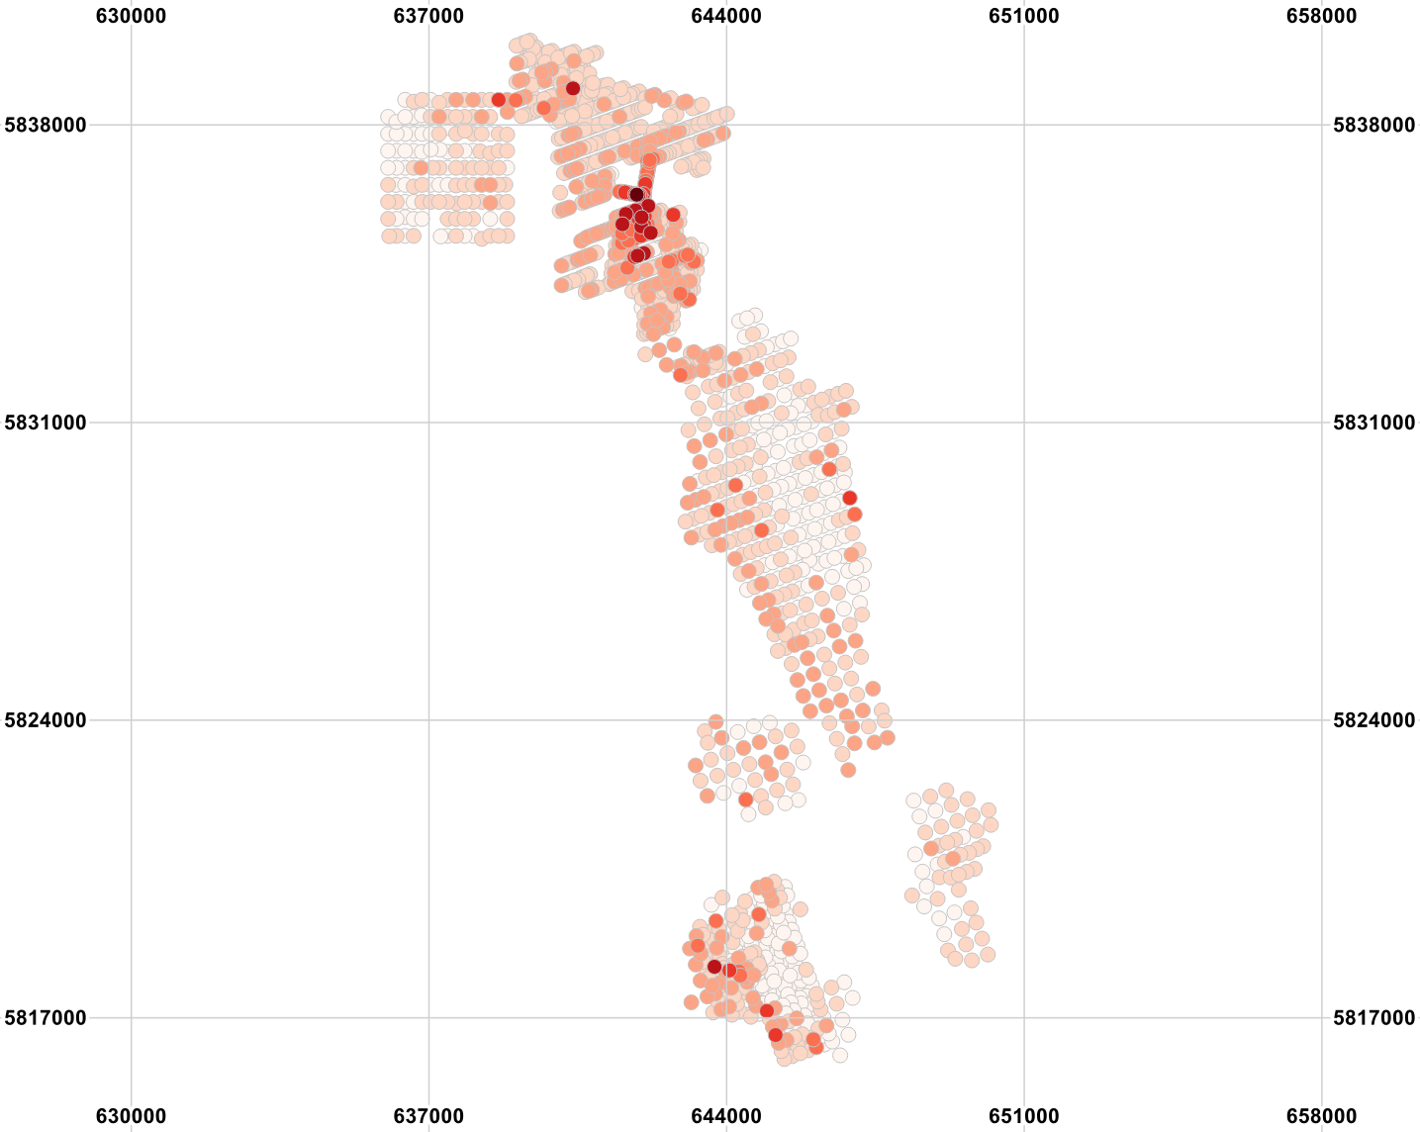
Location map – soils colored by Bi
Figure 2B: Soil sample locations for the Stavely project area colored by Bi concentration. The area in the magenta oval showed Cu enrichment. Copper and Bi should not be enriched in the same part of the system. This leads to a lower score in the area despite there being clear metal enrichment.

Slide 10
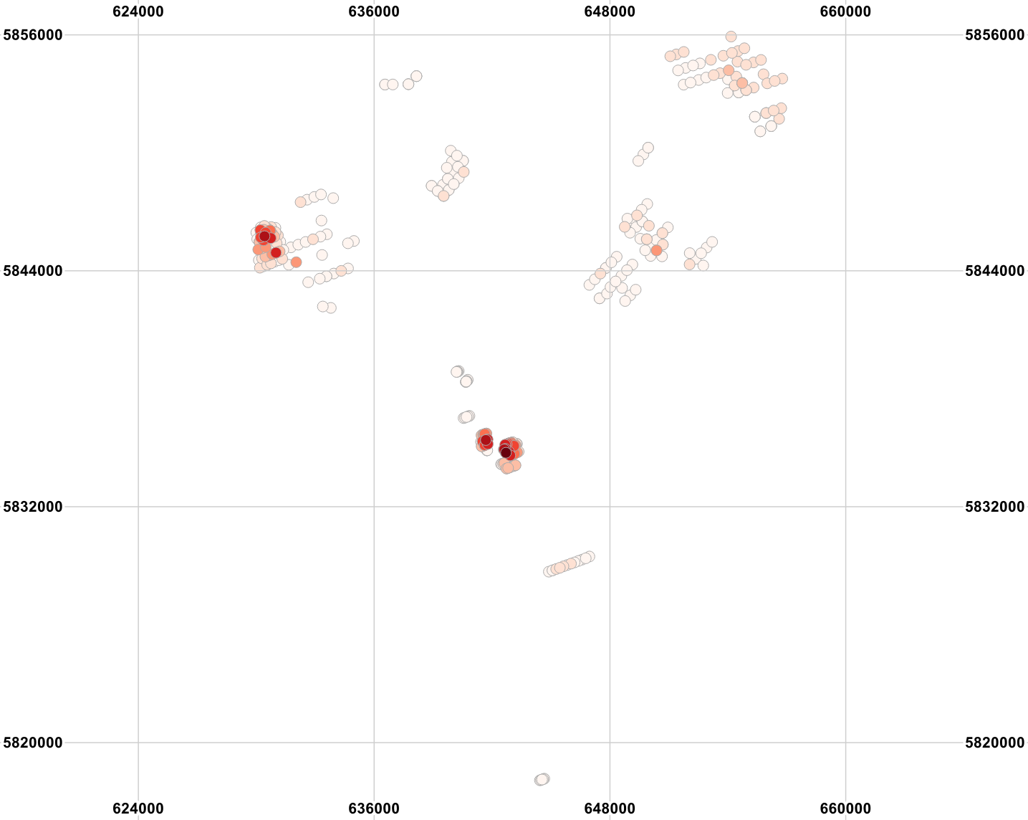
Location map – air core colored by Cu
Figure 2C: Air core sample locations for the Stavely project area colored by Cu concentration. The area inside the magenta oval corresponds to the area high in Cu in the soil assays in the eastern part of the magenta oval in Figure 2A.

Slide 11
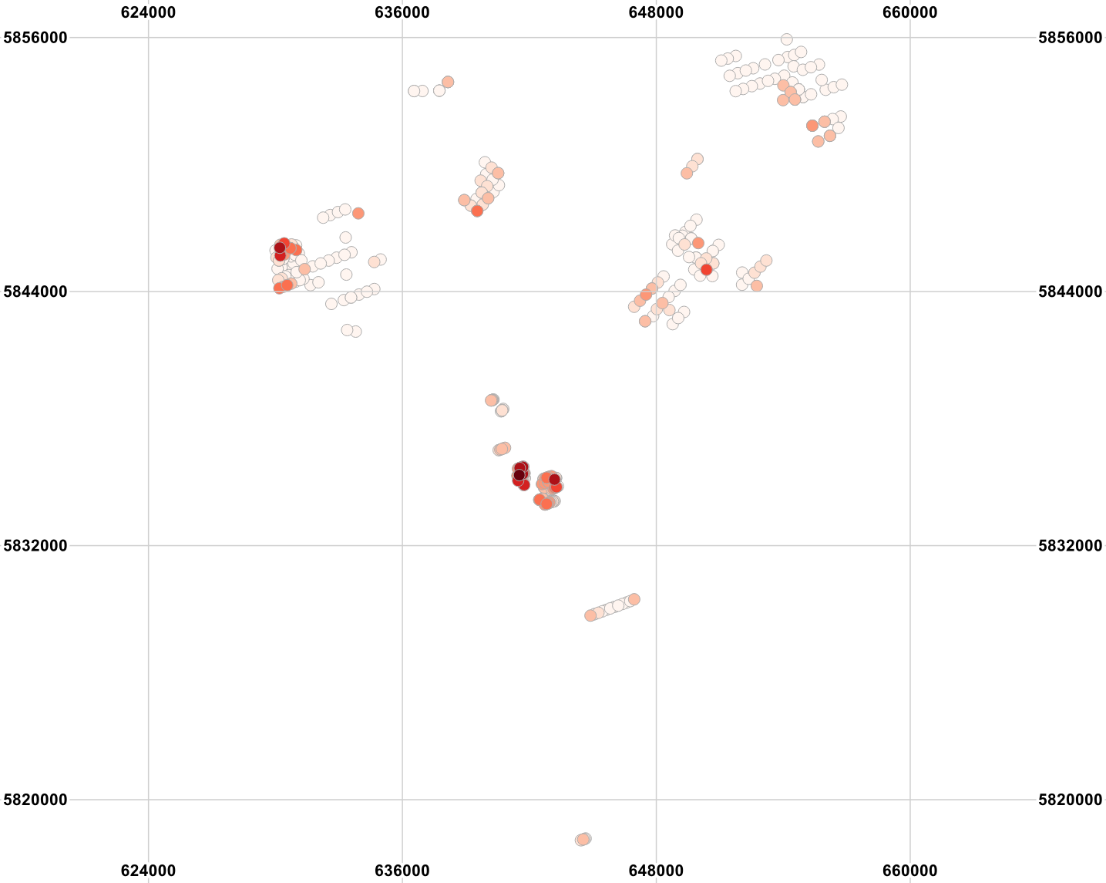
Location map – air core colored by Bi
Figure 2D: Air core sample locations for the Stavely project area colored by Bi concentration. As with the soil samples, Bi and Cu are both enriched in the area.

Slide 12
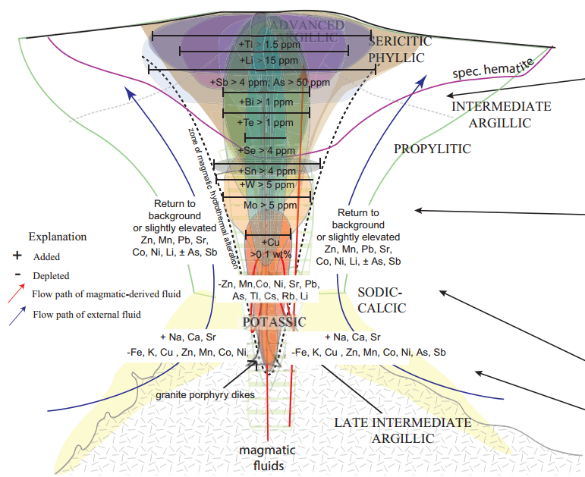
Halley geochemical model
Figure 3: Image showing the interpreted geochemical zonation around porphyry copper systems based on Ann-Mason as well as other porphyry systems from Halley et al (2015).

Slide 13
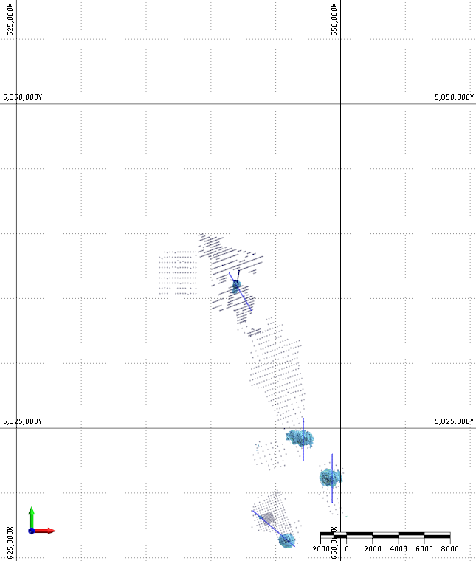
Location map – soils colored by Cu
Fig 10
FG-Stavely-S-1
FG-Stavely-S-2
Fig 7
Fig 6
FG-Stavely-S-3
FG-Stavely-S-Epi1
Fig 8
FG-Stavely-S-4
03_Stavely_Soils_Halley_90th_3DTargeting_0p1
Figure 4: The image above shows the 0.1 isosurface of the results for soil data using a model built using the Halley model geometry with thresholds based on the 90th percentile of the soil data. Four porphyry targets and one epithermal target are highlighted by the analysis. Target FG-Stavely-S-3 is the highest scoring though FG-Stavely-S-1 and FG-Stavely-S-Epi1 show more metal enrichment around the targets. Cross sections through the targets are shown in the figures indicated above.

Slide 14
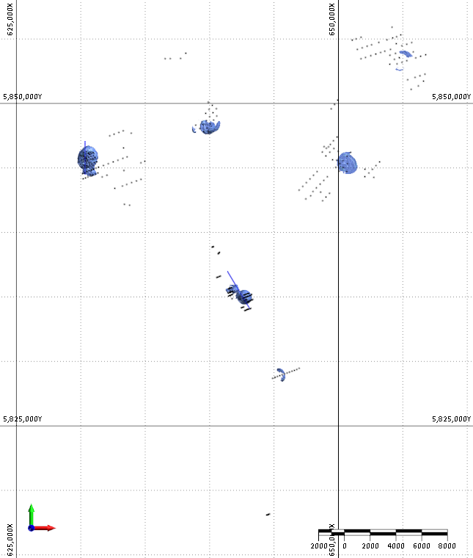
Location map – soils colored by Cu
FG-Stavely-AC-1
Fig 9
FG-Stavely-AC-2
Fig 10
FG-Stavely-AC-3A
FG-Stavely-AC-3B
02_Stavely_Aircore_Halley_3DTargeting_0p1
Figure 5: The image above shows the 0.1 isosurface of the results for the air core data using the Halley model. Four porphyry targets are highlighted by the analysis. Target FG-Stavely-AC-2 is both the highest scoring and best constrained target. Target FG-Stavely-AC-3A is coincident with target FG-Stavely-S-1. Cross sections through some of the targets are shown in the figures indicated above.

Slide 15
Targeting results section view – FG-Stavely-S-3
N
S
FG-NZ-Soils2023-2
03_Stavely_Soils_Halley_90th_3DTargeting_0p1 (cyan)
04_Stavely_Soils_Halley_90th_3DTargeting_0p11 (light green)
05_Stavely_Soils_Halley_90th_3DTargeting_0p12 (green)
06_Stavely_Soils_Halley_90th_3DTargeting_0p13 (yellow green)
07_Stavely_Soils_Halley_90th_3DTargeting_0p14 (yellow)
08_Stavely_Soils_Halley_90th_3DTargeting_0p16 (orange)
09_Stavely_Soils_Halley_90th_3DTargeting_0p18 (dark orange)
10_Stavely_Soils_Halley_90th_3DTargeting_0p2 (red)
Figure 6: Cross section through target FG-Stavely-S-3 showing isosurface values from 0.1 to 0.2. The section is north-south oriented at an easting of 649350. The target has a shallower part approximately 500m below the surface and a deep part that is close to 2km deep. Air core sampling should be completed over the target. Air core data should be better at discriminating the depth to the target.

Slide 16
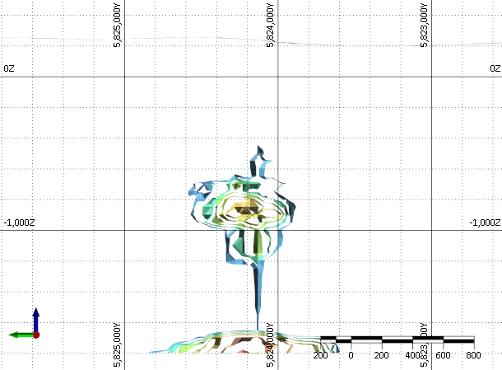
Targeting results section view – FG-Stavely-S-2
N
S
FG-NZ-Soils2023-2
03_Stavely_Soils_Halley_90th_3DTargeting_0p1 (cyan)
04_Stavely_Soils_Halley_90th_3DTargeting_0p11 (light green)
05_Stavely_Soils_Halley_90th_3DTargeting_0p12 (green)
06_Stavely_Soils_Halley_90th_3DTargeting_0p13 (yellow green)
07_Stavely_Soils_Halley_90th_3DTargeting_0p14 (yellow)
08_Stavely_Soils_Halley_90th_3DTargeting_0p16 (orange)
09_Stavely_Soils_Halley_90th_3DTargeting_0p18 (dark orange)
Figure 7: Cross section through target FG-Stavely-S-2 showing isosurface values from 0.1 to 0.18. The section is north-south oriented at an easting of 647130. The target has a shallower part approximately 1km below the surface and a deep part that is close to 2km deep. The target should be evaluated as a possible deep porphyry or epithermal target. Air core sampling over the target area should help determine which mineralization style is more likely.

Slide 17
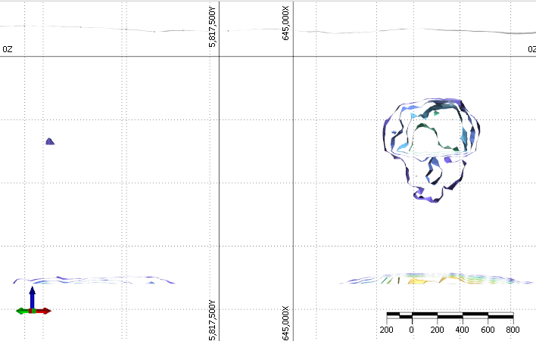
Targeting results section view – FG-Stavely-S-4 and FG-Stavely-S-Epi1
NW
SE
FG-NZ-Soils2023-2
FG-Stavely-S-4
FG-Stavely-S-Epi1
01_Stavely_Soils_Halley_90th_3DTargeting_0p08 (dark blue)
02_Stavely_Soils_Halley_90th_3DTargeting_0p09 (light blue)
03_Stavely_Soils_Halley_90th_3DTargeting_0p1 (cyan)
04_Stavely_Soils_Halley_90th_3DTargeting_0p11 (light green)
05_Stavely_Soils_Halley_90th_3DTargeting_0p12 (green)
06_Stavely_Soils_Halley_90th_3DTargeting_0p13 (yellow green)
07_Stavely_Soils_Halley_90th_3DTargeting_0p14 (yellow)
08_Stavely_Soils_Halley_90th_3DTargeting_0p16 (orange)
Figure 8: Cross section through targets FG-Stavely-S-4 and FG-Stavely-S-Epi1 showing isosurface values from 0.08 to 0.16. The section is oriented northwest to southeast. The Epi1 area shows more significant metal enrichment than the S4 area. However, the elements are not zoned in the way the model predicts, so the scores are lower. The deeper target at S4 scores higher than the shallower target, so both may be epithermal targets. Air core drilling should help determine the style of mineralization that is most likely.

Slide 18
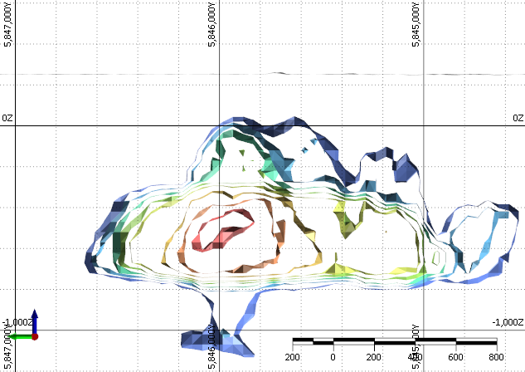
Targeting results section view – FG-Stavely-AC-2
N
S
FG-NZ-Soils2023-2
02_Stavely_Aircore_Halley_3DTargeting_0p12 (blue)
03_Stavely_Aircore_Halley_3DTargeting_0p12 (light blue)
04_Stavely_Aircore_Halley_3DTargeting_0p14 (cyan)
05_Stavely_Aircore_Halley_3DTargeting_0p16 (green)
06_Stavely_Aircore_Halley_3DTargeting_0p18 (yellow)
07_Stavely_Aircore_Halley_3DTargeting_0p22 (orange)
08_Stavely_Aircore_Halley_3DTargeting_0p26 (dark orange)
09_Stavely_Aircore_Halley_3DTargeting_0p3 (red)
Figure 9: Cross section through target FG-Stavely-AC-2 showing isosurface values from 0.12 to 0.3. The section is north-south oriented at an easting of 630330. The target scores quite highly and is reasonably well constrained. It should be considered high priority for follow-up work. Additional sampling over the target would help better constrain the location and depth.

Slide 19
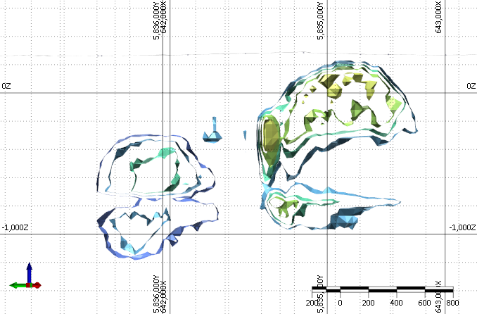
Targeting results section view – FG-Stavely-S-1, FG-Stavely-AC-3A
NW
SE
FG-Stavely-AC-3B
FG-NZ-Soils2023-2
FG-Stavely-S-1
02_Stavely_Soils_Halley_90th_3DTargeting_0p09 (light blue)
03_Stavely_Soils_Halley_90th_3DTargeting_0p1 (cyan)
04_Stavely_Soils_Halley_90th_3DTargeting_0p11 (light green)
03_Stavely_Aircore_Halley_3DTargeting_0p12 (light blue)
04_Stavely_Aircore_Halley_3DTargeting_0p14 (cyan)
05_Stavely_Aircore_Halley_3DTargeting_0p16 (green)
06_Stavely_Aircore_Halley_3DTargeting_0p18 (yellow)
Figure 10: Cross section through targets FG-Stavely-S-1 and FG-Stavely-AC-3B comparing the targets. The section is oriented northwest to southeast. The soils target is NW of the air core target. No air core samples are present over the soils target. The soils target is deeper than the air core target because the soils target area is high in Bi and Te, which are both typically above the core in a porphyry system. It is possible that these are part of the same target and it has just been tilted with the top towards the NW and core towards the SE.

